Slide 1





1776-2026
1777-2027
Waterbury VT250
To encourage, support, develop, and promote activities that honor, elevate, and celebrate the complex history of 250 years in the United States and the Republic of Vermont.
December 2025 update
https://www.waterburyvt.com/community/vt250

Slide 2


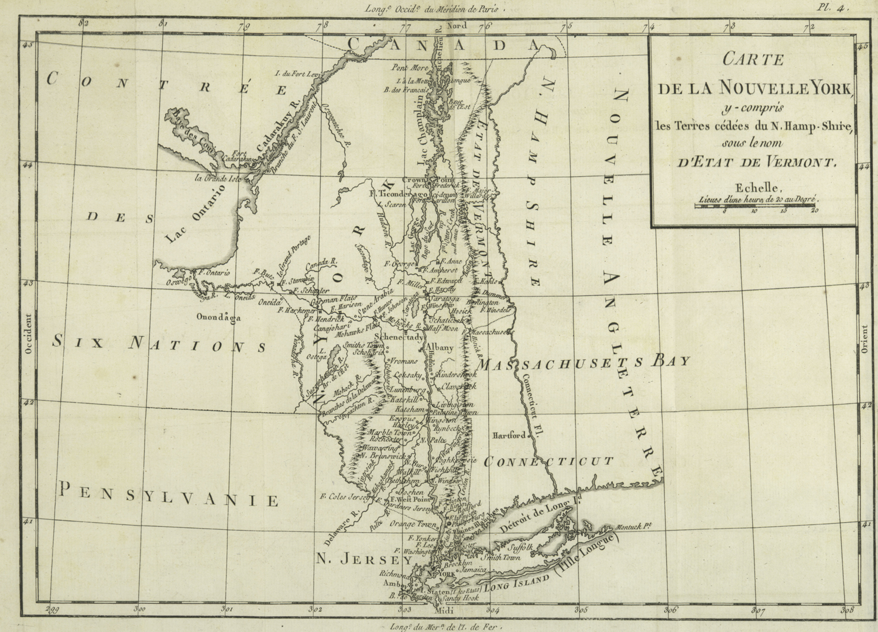
Waterbury Committee
Cheryl Casey, Chair
Laura Parette, Secretary
Michael Bard
Judi Byron
Joe Camaratta
Roger Clapp
Bryan Farnsworth
Carolyn Fox
Ryan Geary
Emily Gilde
Evan Karl Hoffman
Ariel Mondlak
https://www.waterburyvt.com/community/vt250

Slide 3
WATERBURY Committee
Membership represents:
Community Members
Historical Society
Library
Revitalizing Waterbury
Rotary
Select Board

Slide 4

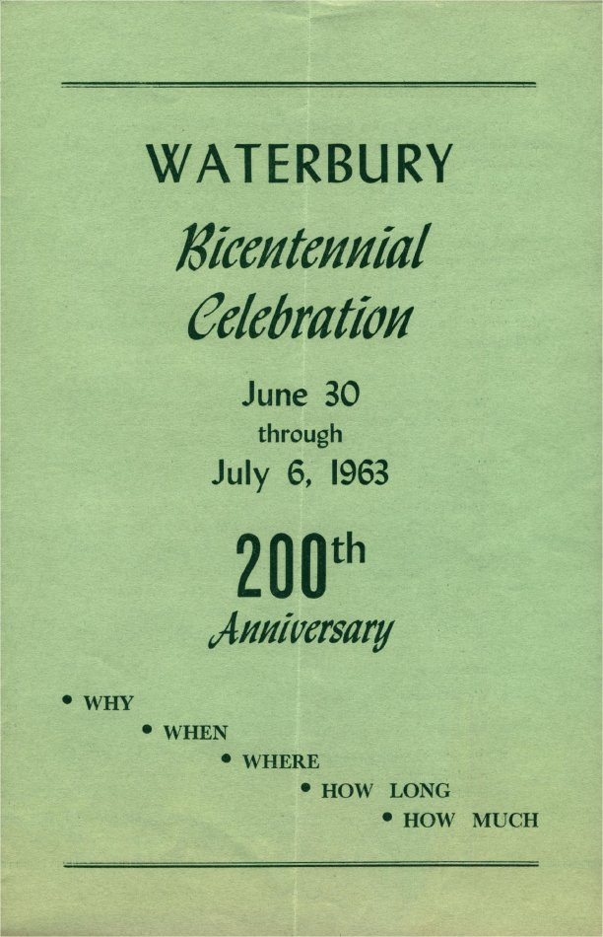
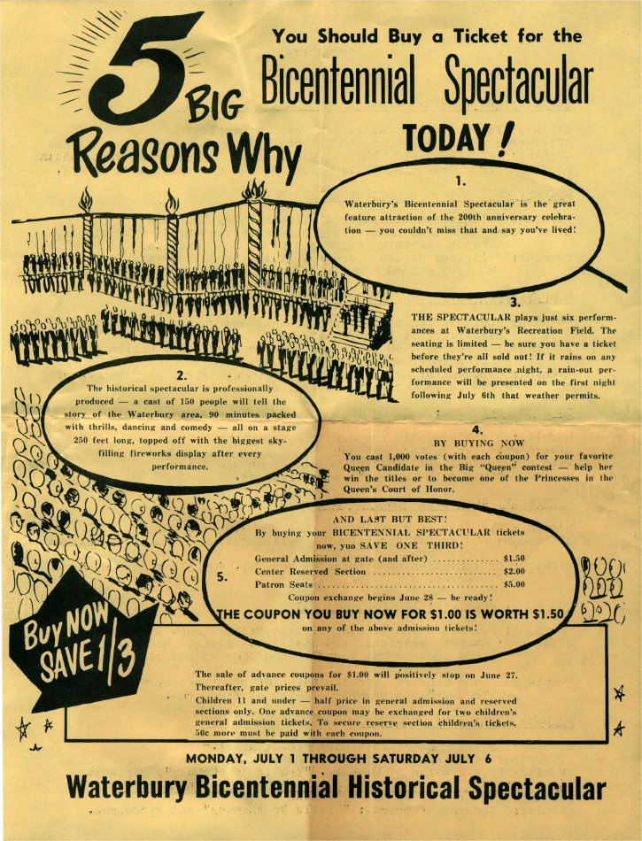

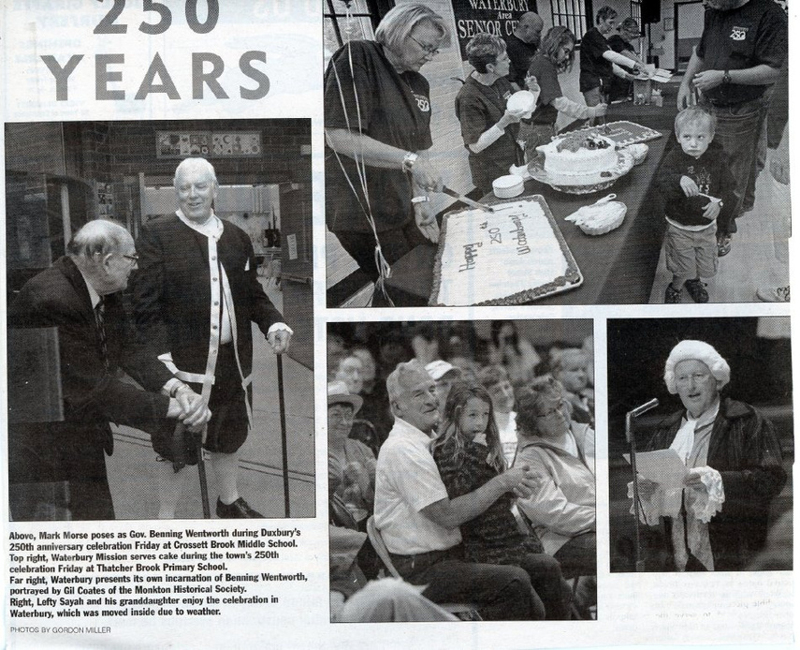

Waterbury’s #legacy of celebrating

Slide 5
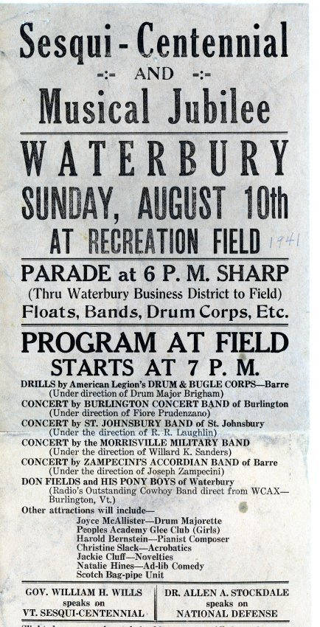
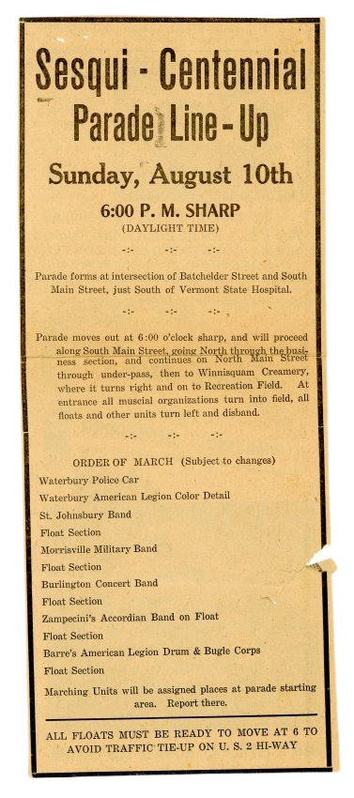

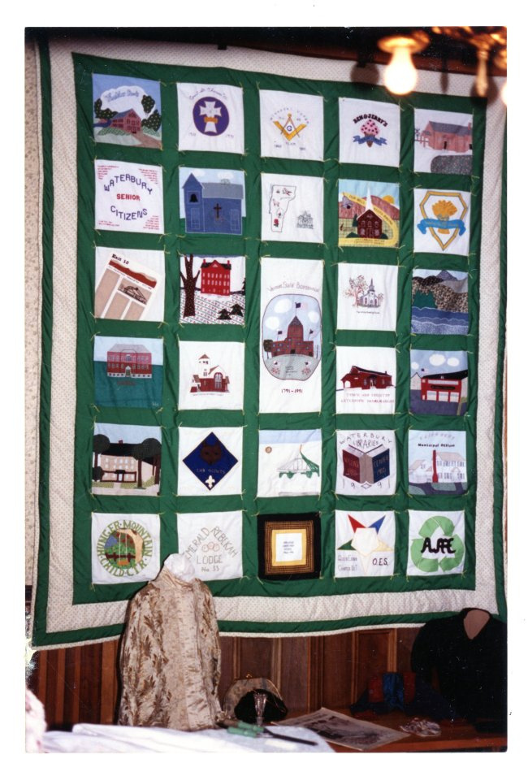
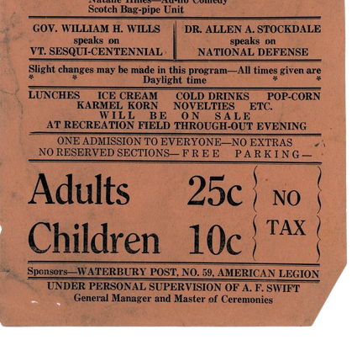
Waterbury’s #legacy of celebrating

Slide 6



CURRENT PRIORITIES
Domain name & website:
waterburyvt250.com
Dedicated logo
Social media accounts:
@waterburyvt250
Grant applications:
Vermont Humanities Project Grants (up to $5K)
Vermont 250th Community Planning Grants (up to $1K)
Education & outreach
Tailored one-sheets for different audiences (businesses, civic & faith organizations, general community)

Slide 7
(partial list)
CURRENT PRIORITIES
Documentary screening & discussion event
Federalist Papers reading & discussion group
History passport initiative
NQID parade theme

Slide 8
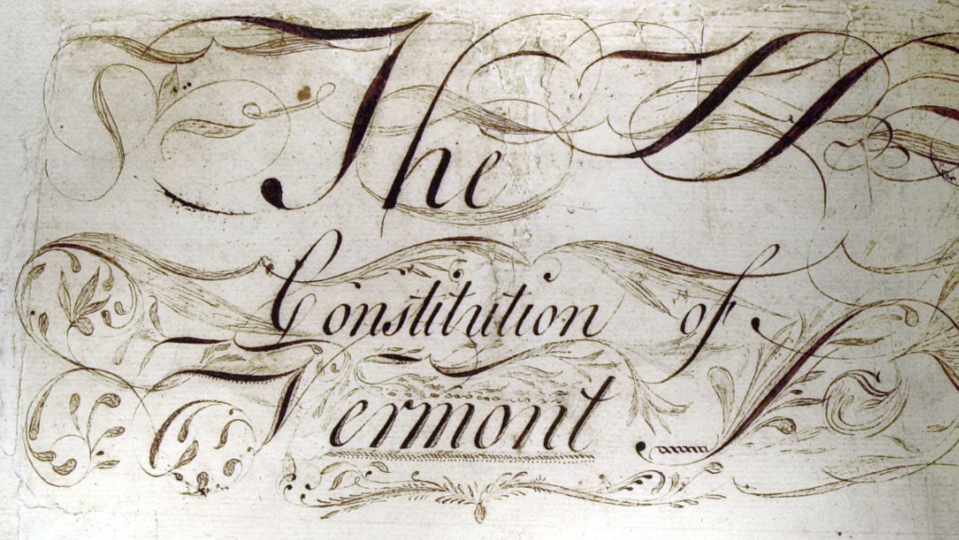
budget
ITEM | AMOUNT
Domain name and website (2 years) | $1,100
Print costs (informational one-sheets/brochures, event posters, banners, signs, postcards) | $1,500
Event supplies (refreshments, contest prizes, event materials) | $900
TOTAL ASK:
$3,500

Slide 9



Thank You
WATERBURY VT250

